Slide 1


Ph.D. Dissertation Defense
Body-SLAM: Simultaneous Localization and Mapping inside the Human Body
PhD Candidate:
Guanqun Bao Electrical & Computer Engineering Department
Committee:
Prof. Kaveh Pahlavan - ECE Department , WPI (academic advisor)
Prof. Yehia Massoud - ECE Department, WPI
Prof. Lifeng Lai - ECE Department, WPI
Prof. Emanuel Agu - CS Department, WPI
Dr. Allen Levesque - ECE Department, WPI
Dr. Kamran Sayrafian - NIST

Slide 2
Outline
Introduction
Motivation & Contribution of the Research
Methodology : Body-SLAM
Performance Evaluation
Conclusion
Publications

Slide 3
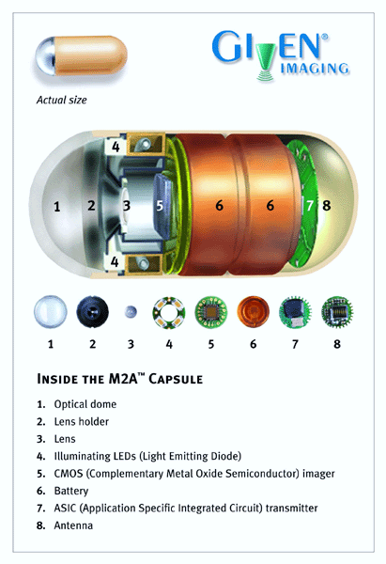
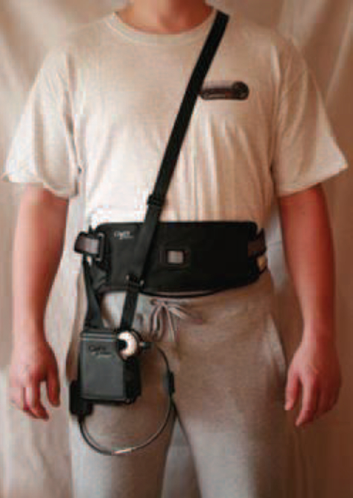
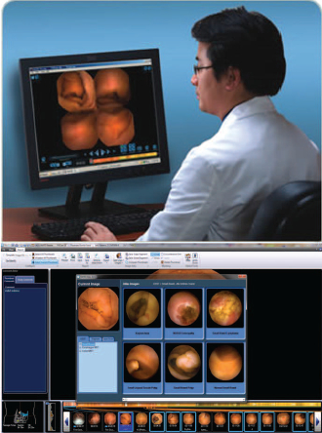
Localization of wireless capsule endoscope (WCE)
Endoscope
Portable recorder
Display workstation
image source Given Imaging http://www.givenimaging.com/en-us/Pages/default.aspx

Slide 4
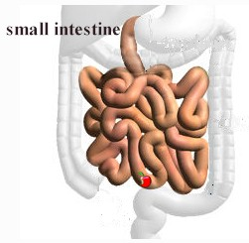



Motivation
Challenges:
Experiment inside human body is extremely difficult.
We don’t have any map of inside the small intestine. CT and X-ray cannot provide map inside the small intestine.
Since we don’t have a map, validation of existing localization algorithms is challenging.
Conventional single sourced RF localization can not provide satisfactory accuracy.
Notes:
For 13 years, no accurate localization systems are invented. The major challenges are:

Slide 5
Contribution
Our overall contribution is to design an environment for performance evaluation of hybrid visual/RF localization algorithms for simultaneous localization and mapping techniques inside the human body (Body-SLAM). This was the work of several students. I worked with the previous PhD student, Yunxing Ye, to demonstrated the in-adequacy of RF localization inside the small intestine, I worked with another MS student, Liang Mi, to design a visualization testbed, and my contributions were focused on performance evaluation methodology for Body-SLAM. Specifically:
I modeled the movements of the WCE using empirical data
I defined a typical path of movement inside the small intestine
I used the path and empirical motion model inside a human body to generate the received signal on the surface of the human body
We used the same path and empirical motion model to emulate the visualization of inside the small intestine
I used algorithms to integrate the results of visualization and RF signal signature for a Body-SLAM algorithm
Notes:
CT and X-ray can not provide enough resolution to distinguish the distribution of small intestine.

Slide 6
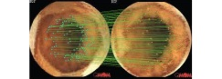


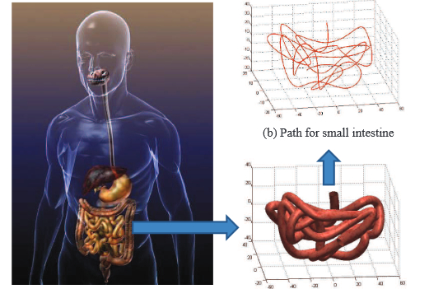
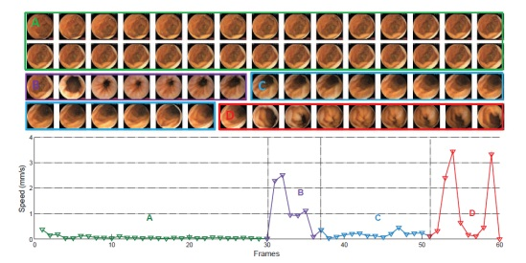
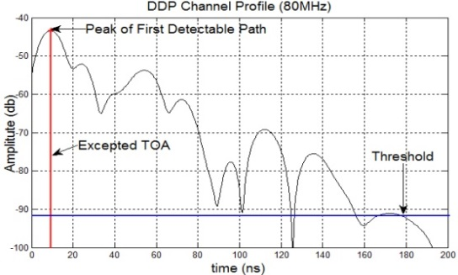
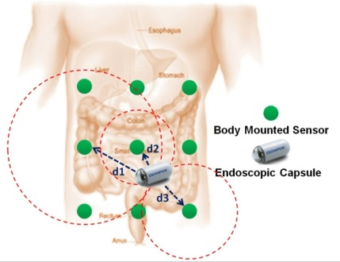
Proposed methodology: Body-SLAM
Modeling the Speed of WCE using Endoscopic Images
Define a typical path of small intestine and used the same path and empirical motion model to emulate the visualization inside the small intestine
Motion tracking using images
Enhance the localization accuracy
Use the path and empirical motion model inside a human body to generate the received signal on the surface of the human body
Algorithm design for RF localization
Reconstruct the map for small intestine
RF localization
Overall flow chart of Body-SLAM
  G. Bao, L. Mi and K. Pahlavan, "Emulation on Motion Tracking of Endoscopic Capsule inside Small Intestine", 2013 World Congress in Computer Science, Computer Engineering, and Applied Computing (WORLDCOMP'13), Las Vegas, USA, 2013.
  G. Bao, L. Mi and K. Pahlavan, "A Video Aided RF Localization Technique for the Wireless Capsule Endoscope (WCE) inside Small Intestine," 8th International Conference on Body Area Networks, Boston, Massachusetts, United States, September 30 - October 2, 2013.
  G. Bao, L. Mi and K. Pahlavan, “Hybrid Localization of Micro-robotic Endoscopic Capsule inside Small Intestine by Data Fusion of Vision and RF Sensors”, submitted to Sensor Journal, IEEE, March, 2014.

Slide 7


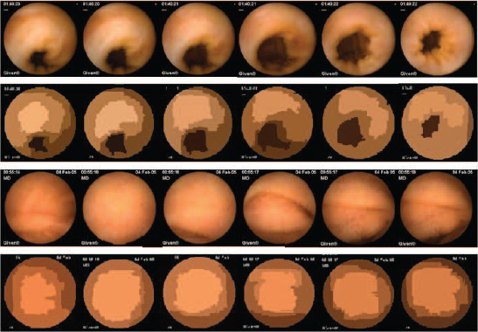

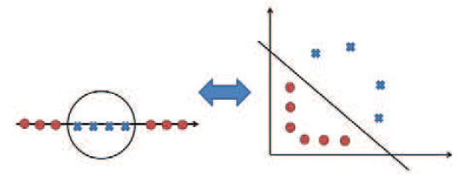
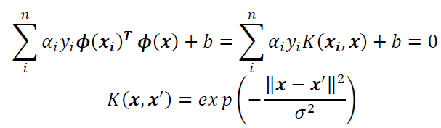
  Analyze the content of endoscopic images
Input endoscopic images
Face tunnel
Face lumen
Statistical region merging (SRM) color segmentation
Feature extraction
Size of darkest region, RGB values for the darkest region….
Support vector machine (SVM) classification
Face tunnel
Face lumen
  G. Bao, Y. Ye, U. Khan, X. Zheng and K. Pahlavan, "Modeling of the Movement of the Endoscopy Capsule inside GI Tract based on the Captured Endoscopic Images" , The 2012 International Conference on Modeling, Simulation and Visualization Methods (MSV), Las Vegas, USA, July, 2012.

Slide 8
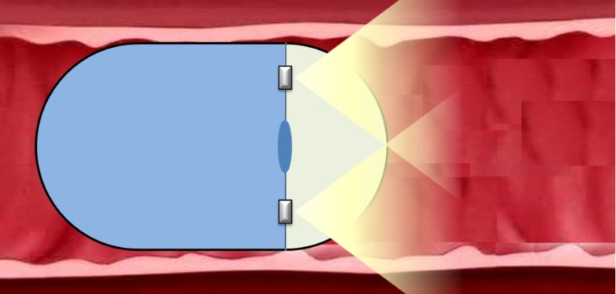
  Speed estimation using endoscopic images
The translation of the endoscopic capsule inside the small intestine can be modeled as a tiny camera passing through a elastic cylindrical tube [1-2]. The most recent WCE released by Given Imaging is able to continuously takes pictures at a rate up to 6 frames/sec. Common portions of the scene (feature points) may present between consecutive images. The pattern and magnitudes of the displacements of these feature points can be used as a hint to reveal the speed of the endoscopic capsule [3-6].
Transition of WCE inside small intestine
A sequence of consecutive images taken by the endoscopic capsule inside small intestine
D. O. Faigel and D. R. Cave, Capsule endoscopy. Saunders Elsevier Amsterdam, 2008.
G. Iddan , G. Meron, and A.Glukhovsky, et al. Wireless capsule endoscopy. Nature, 2000, 405: 417.
P. M. Szczypinski, R. D. Sriram, P. V. Sriram, D. N. Reddy et al., “A model of deformable rings for interpretation of wireless capsule endoscopic videos,” Medical Image Analysis, vol. 13, no. 2, p. 312, 2009.
D. J. MirotaI., M. shii and G. D. Hager , “Vision-based navigation in image-guided interventions , “ Annual review of biomedical engineering, vol13: 297-319. 2011.
E. Spyrou and D. Iakovidis. "Video-based measurements for wireless capsule endoscope tracking," Measurement Science and Technology, vol 25(1): 015002, 2014.
F. De Iorio, C. Malagelada, F. Azpiroz, M. Maluenda, C. Violanti, L. Igual, J. Vitri`a, and J.-r. Malagelada, “Intestinal motor activity, endoluminal motion and transit,” Neurogastroenterology & Motility, vol. 21, no. 12, pp. 1264–e119, 2009.

Slide 9
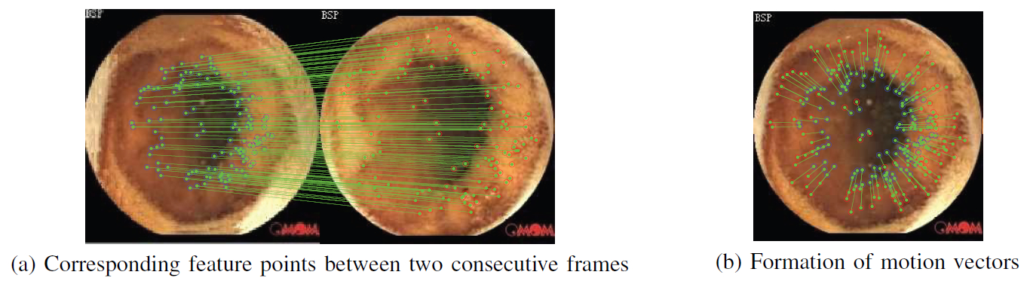
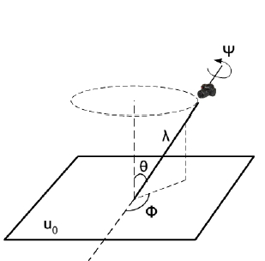
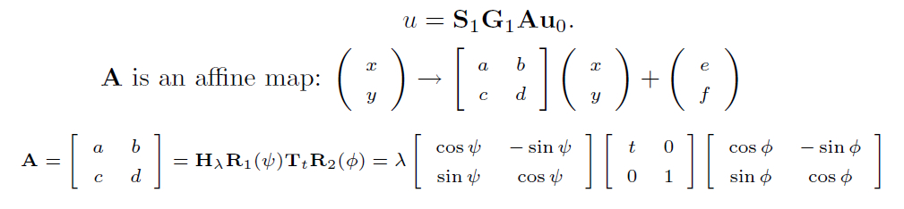
  Feature points matching using A-SIFT
G. Bao, L. Mi and K. Pahlavan, "A Video Aided RF Localization Technique for the Wireless Capsule Endoscope (WCE) inside Small Intestine," 8th International Conference on Body Area Networks, Boston, Massachusetts, United States, September 30 - October 2, 2013.
G. Bao, Y. Ye, U. Khan, X. Zheng and K. Pahlavan, "Modeling of the Movement of the Endoscopy Capsule inside GI Tract based on the Captured Endoscopic Images" , The 2012 International Conference on Modeling, Simulation and Visualization Methods (MSV), Las Vegas, USA, July, 2012.
G. Bao, L. Mi, Y. Geng and K. Pahlavan, “A Computer Vision based Speed Estimation Technique for Localizing the Wireless Capsule Endoscope inside Small Intestine,” submitted to Signal Processing Letters, IEEE, April, 2014.

Slide 10
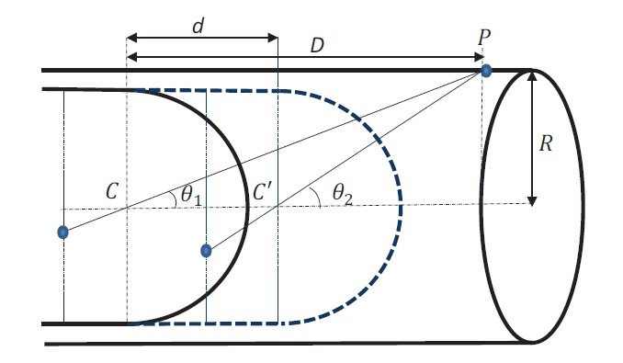
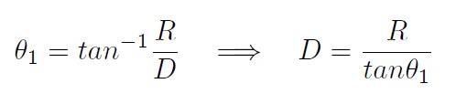

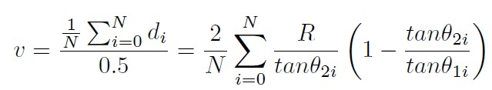
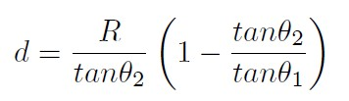

  Geometric model of speed estimation
P : a feature point detected on the lumen
C : initial position of the capsule
C’: position of the capsule after moving by “d”
R : radius of the intestinal tube
$θ_{1}$: angular depth
Fig. 9 speed estimation [1]
G. Bao, L. Mi and K. Pahlavan, "A Video Aided RF Localization Technique for the Wireless Capsule Endoscope (WCE) inside Small Intestine," 8th International Conference on Body Area Networks, Boston, Massachusetts, United States, September 30 - October 2, 2013.
G. Bao, Y. Ye, U. Khan, X. Zheng and K. Pahlavan, "Modeling of the Movement of the Endoscopy Capsule inside GI Tract based on the Captured Endoscopic Images" , The 2012 International Conference on Modeling, Simulation and Visualization Methods (MSV), Las Vegas, USA, July, 2012.
G. Bao, L. Mi, Y. Geng and K. Pahlavan, “A Computer Vision based Speed Estimation Technique for Localizing the Wireless Capsule Endoscope inside Small Intestine,” submitted to Signal Processing Letters, IEEE, April, 2014.

Slide 11
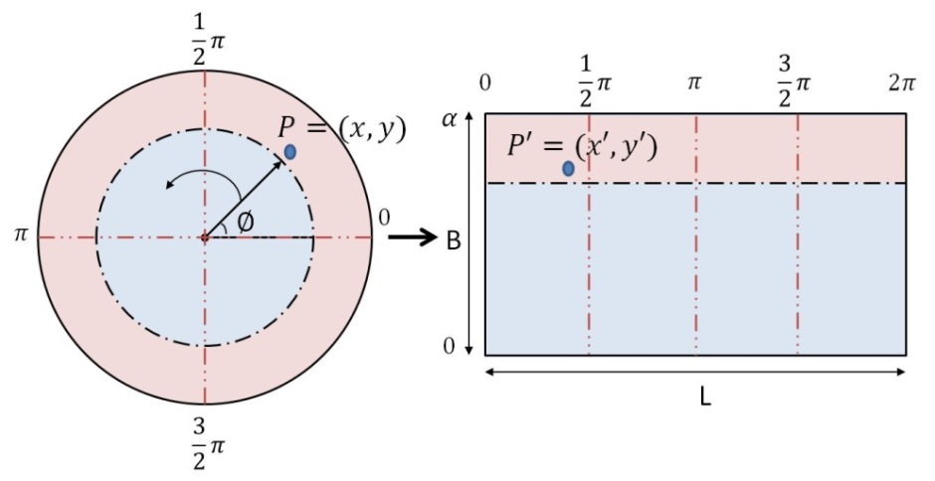



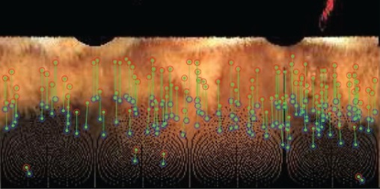

  Image unrolling
To facilitate the calculation of $θ$, we need to implement a image unrolling process, to map the original image onto a flat view plane.
G. Bao, L. Mi and K. Pahlavan, "A Video Aided RF Localization Technique for the Wireless Capsule Endoscope (WCE) inside Small Intestine," 8th International Conference on Body Area Networks, Boston, Massachusetts, United States, September 30 - October 2, 2013.
G. Bao, Y. Ye, U. Khan, X. Zheng and K. Pahlavan, "Modeling of the Movement of the Endoscopy Capsule inside GI Tract based on the Captured Endoscopic Images" , The 2012 International Conference on Modeling, Simulation and Visualization Methods (MSV), Las Vegas, USA, July, 2012.
G. Bao, L. Mi, Y. Geng and K. Pahlavan, “A Computer Vision based Speed Estimation Technique for Localizing the Wireless Capsule Endoscope inside Small Intestine,” submitted to Signal Processing Letters, IEEE, April, 2014.

Slide 12
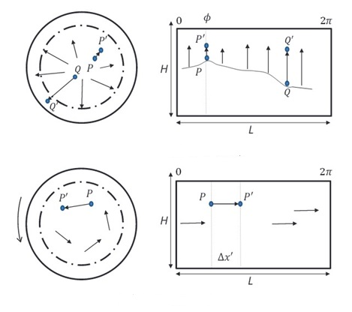



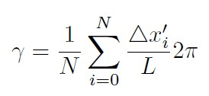
Motion Tracking: direction estimation
Fig. 11 direction estimation [9]
G. Bao, L. Mi and K. Pahlavan, "A Video Aided RF Localization Technique for the Wireless Capsule Endoscope (WCE) inside Small Intestine," 8th International Conference on Body Area Networks, Boston, Massachusetts, United States, September 30 - October 2, 2013.
G. Bao, Y. Ye, U. Khan, X. Zheng and K. Pahlavan, "Modeling of the Movement of the Endoscopy Capsule inside GI Tract based on the Captured Endoscopic Images" , The 2012 International Conference on Modeling, Simulation and Visualization Methods (MSV), Las Vegas, USA, July, 2012.
G. Bao, L. Mi, Y. Geng and K. Pahlavan, “A Computer Vision based Speed Estimation Technique for Localizing the Wireless Capsule Endoscope inside Small Intestine,” submitted to Signal Processing Letters, IEEE, April, 2014.

Slide 13
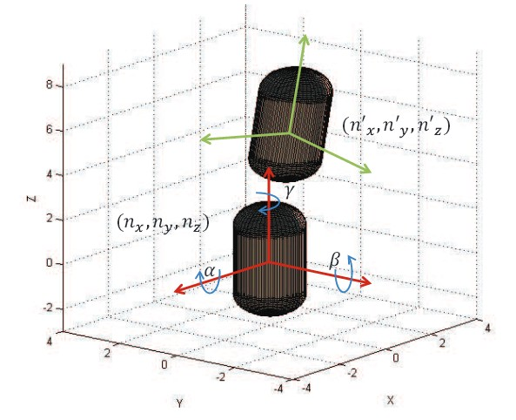
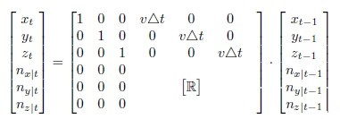

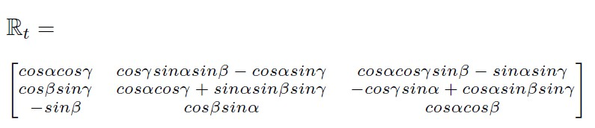
Motion Tracking: direction estimation
Motion state estimation using linear transition matrix [9]
G. Bao, L. Mi and K. Pahlavan, "A Video Aided RF Localization Technique for the Wireless Capsule Endoscope (WCE) inside Small Intestine," 8th International Conference on Body Area Networks, Boston, Massachusetts, United States, September 30 - October 2, 2013.
G. Bao, Y. Ye, U. Khan, X. Zheng and K. Pahlavan, "Modeling of the Movement of the Endoscopy Capsule inside GI Tract based on the Captured Endoscopic Images" , The 2012 International Conference on Modeling, Simulation and Visualization Methods (MSV), Las Vegas, USA, July, 2012.
G. Bao, L. Mi, Y. Geng and K. Pahlavan, “A Computer Vision based Speed Estimation Technique for Localizing the Wireless Capsule Endoscope inside Small Intestine,” submitted to Signal Processing Letters, IEEE, April, 2014.

Slide 14


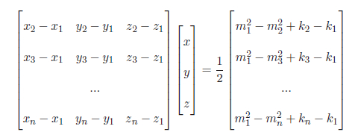

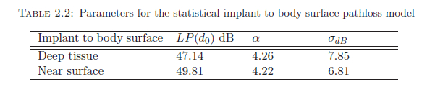
RF Components
Pathloss model
Existing RF localization infrastructure
G. Bao, L. Mi and K. Pahlavan, "A Video Aided RF Localization Technique for the Wireless Capsule Endoscope (WCE) inside Small Intestine," 8th International Conference on Body Area Networks, Boston, Massachusetts, United States, September 30 - October 2, 2013.
G. Bao, Y. Ye, U. Khan, X. Zheng and K. Pahlavan, "Modeling of the Movement of the Endoscopy Capsule inside GI Tract based on the Captured Endoscopic Images" , The 2012 International Conference on Modeling, Simulation and Visualization Methods (MSV), Las Vegas, USA, July, 2012.
Kamran Sayrafian-Pour, Wen-Bin Yang, John Hagedorn, Judith Terrill, and Kamya Yekeh Yazdandoost. A statistical path loss model for medical implant communication channels. In Personal, Indoor and Mobile Radio Communications, 2009 IEEE 20th International Symposium on, pages 2995–2999. IEEE, 2009.

Slide 15
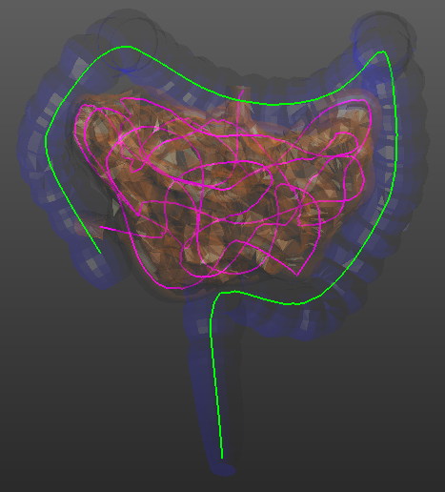
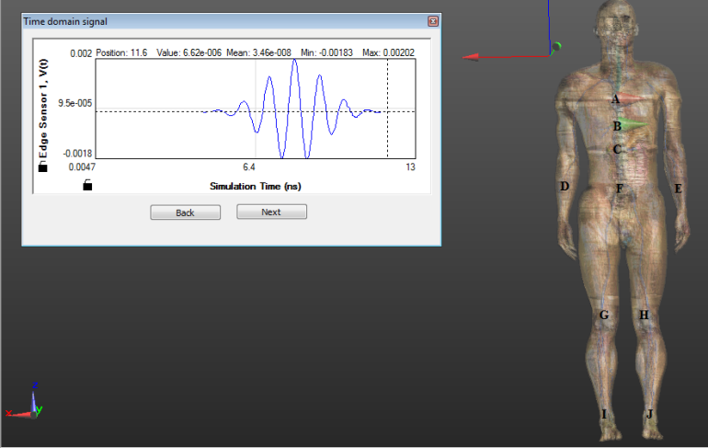
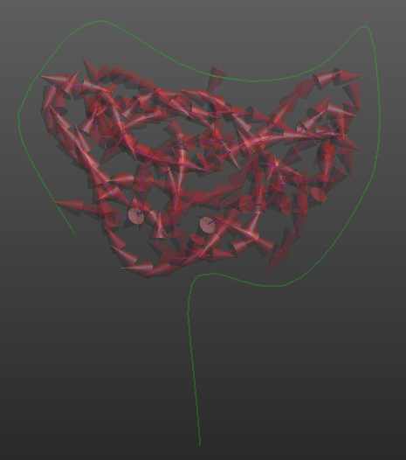
  RF Propagation Emulation & Localization
SEMCAD X is a state-of-the-art 3D full-wave radio propagation simulation platform based on the finite difference time domain (FDTD) [14].
  K. Pahlavan, G. Bao, et al. , "RF localization for wireless video capsule endoscopy". International Journal of Wireless Information Networks, Vol.19 (4), pp.326-340, 2012.
  Z. Liu, J. Chen, U. Khan, B. Alkandari and K. Pahlavan, "Wideband characterization of RF propagation for TOA localization of Wireless video Capsule Endoscope inside small intestine", IEEE 24th International Symposium on Personal Indoor and Mobile Radio Communications (PIMRC), pp 326- 331, London, UK, Sept 11-14, 2013.

Slide 16
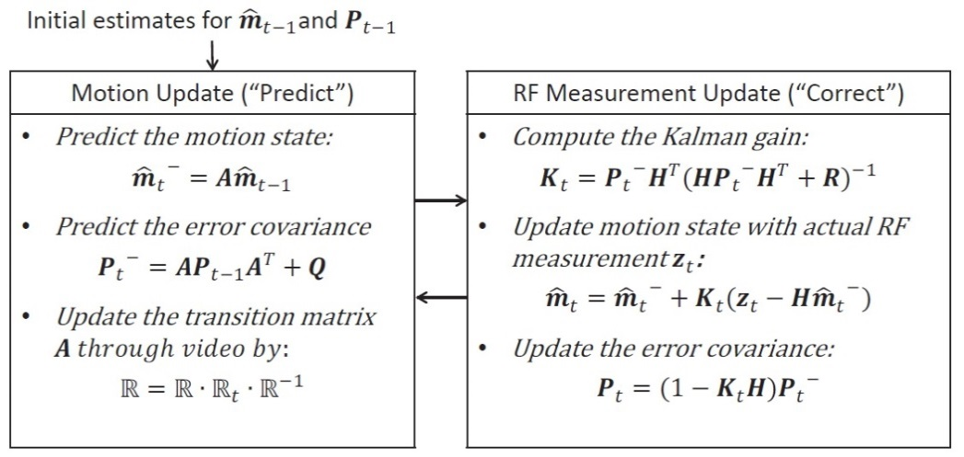
Integrating the images with RF signal
RF localization from measurements
Motion model from images
Fig. 13 Data fusion using Kalman filter [9]
G. Bao, L. Mi and K. Pahlavan, "A Video Aided RF Localization Technique for the Wireless Capsule Endoscope (WCE) inside Small Intestine," 8th International Conference on Body Area Networks, Boston, Massachusetts, United States, September 30 - October 2, 2013.
G. Bao, Y. Ye, U. Khan, X. Zheng and K. Pahlavan, "Modeling of the Movement of the Endoscopy Capsule inside GI Tract based on the Captured Endoscopic Images" , The 2012 International Conference on Modeling, Simulation and Visualization Methods (MSV), Las Vegas, USA, July, 2012.
G. Bao, L. Mi, Y. Geng and K. Pahlavan, “A Computer Vision based Speed Estimation Technique for Localizing the Wireless Capsule Endoscope inside Small Intestine,” submitted to Signal Processing Letters, IEEE, April, 2014.

Slide 17
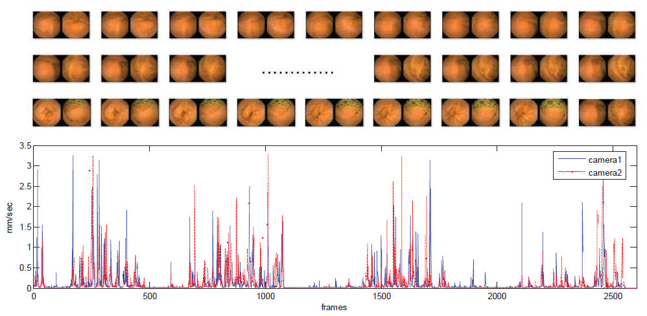
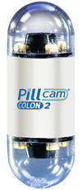
Performance evaluation using clinical data
PillCam COLON 2
The double camera feature of the PillCam COLON 2 is a perfect tool for statistical validation. Since the images taken from both cameras are almost the same but pointing to opposite direction, after applying the speed estimation algorithm, the speed extracted from both cameras should be the same.11
  G. Bao and K. Pahlavan, "Motion Estimation of the Endoscopy Capsule using Region-based Kernel SVM Classifier", 2013 IEEE International Conference on Electro/Information Technology (EIT), Rapid City, SD, May 9-11, 2013.
  G. Bao, L. Mi, Y. Geng and K. Pahlavan, “A Computer Vision based Speed Estimation Technique for Localizing the Wireless Capsule Endoscope inside Small Intestine,” submitted to Signal Processing Letters, IEEE, April, 2014.
  G. Bao, L. Mi, Y. Geng, M. Zhou and K. Pahlavan, “A Video-based Speed Estimation Technique for Localizing the Wireless Capsule Endoscope inside Gastrointestinal Tract, ” submitted to IEEE Engineering in Medicine and Biology Society (EMBC’14), March, 2014.

Slide 18
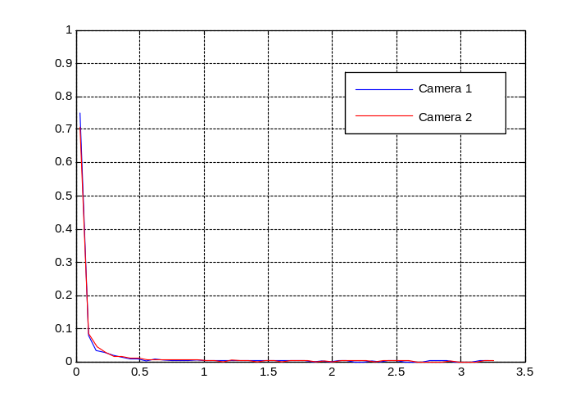
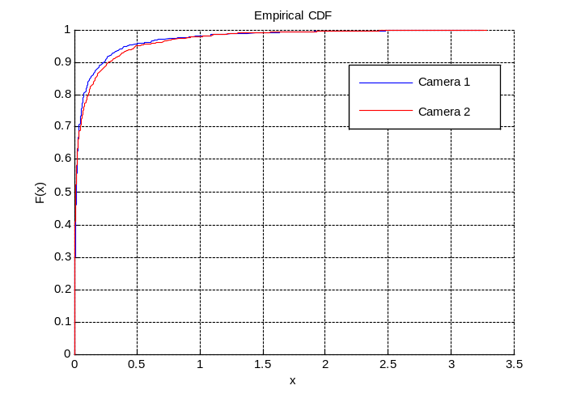
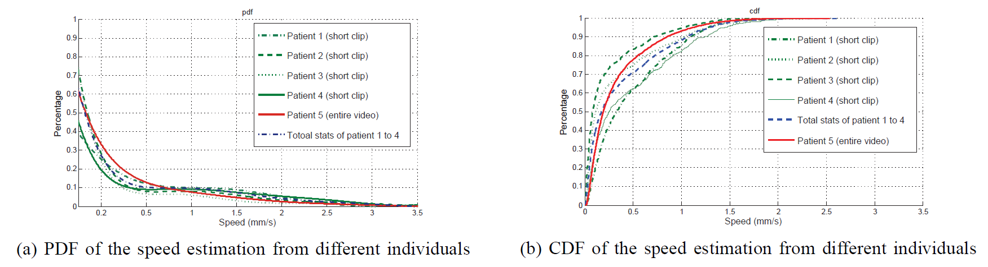
  Modeling the speed of WCE using empirical data
mm/s
mm/s
PDF for speed estimation from both cameras
CDF for speed estimation from both cameras
PDF for speed estimation from different patients
CDF for speed estimation from different patients
G. Bao, L. Mi, Y. Geng, M. Zhou and K. Pahlavan, “A Video-based Speed Estimation Technique for Localizing the Wireless Capsule Endoscope inside Gastrointestinal Tract, ” submitted to IEEE Engineering in Medicine and Biology Society (EMBC’14), March, 2014.
G. Bao, L. Mi and K. Pahlavan, “Hybrid Localization of Micro-robotic Endoscopic Capsule inside Small Intestine by Data Fusion of Vision and RF Sensors”, submitted to Sensor Journal, IEEE, March, 2014.

Slide 19
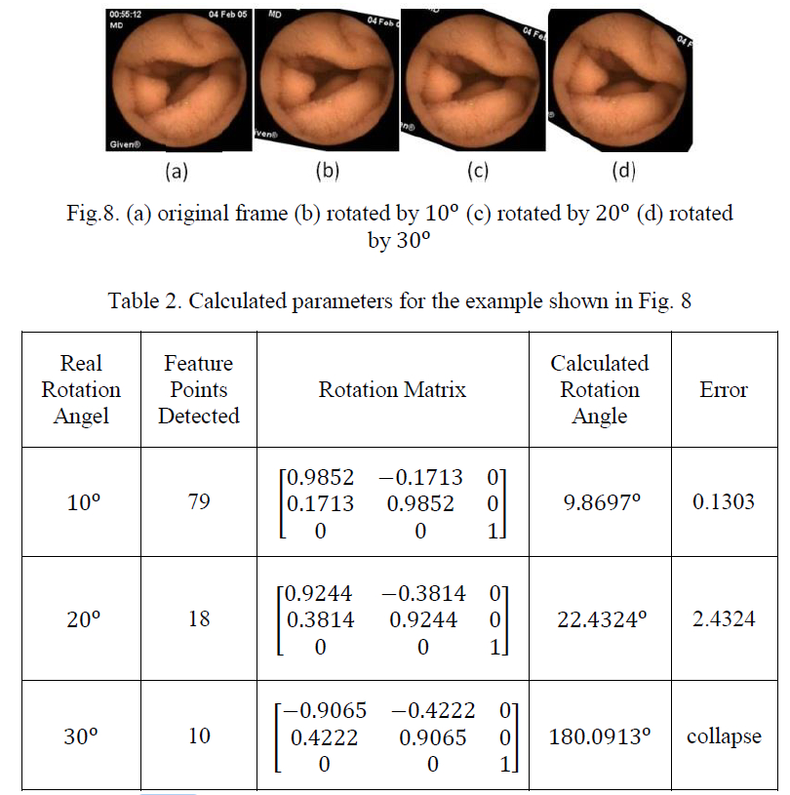

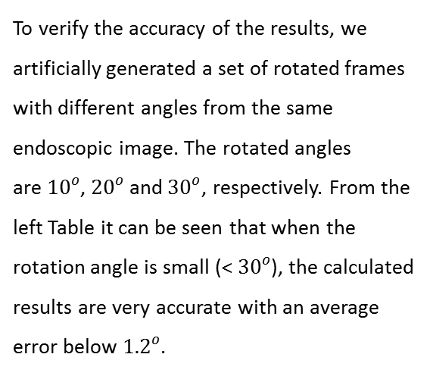
  Testing the rotation of WCE using clinical data
To verify the accuracy of the results, we artificially generated a set of rotated frames with different angles from the same endoscopic image. The rotated angles are${ 10}^{o}$, ${20}^{o}$and${ 30}^{o}$, respectively. From the left Table it can be seen that when the rotation angle is small (<${ 30}^{o}$), the calculated results are very accurate with an average error below${ 1.2}^{o}$.
Figure (a) original frame (b) rotated by ${ 10}^{o}$ (c) rotated by ${20}^{o}$ (d) rotated ${ 30}^{o}$
Estimated rotation angles of the above images
  G. Bao and K. Pahlavan, "Motion Estimation of the Endoscopy Capsule using Region-based Kernel SVM Classifier", 2013 IEEE International Conference on Electro/Information Technology (EIT), Rapid City, SD, May 9-11, 2013.

Slide 20
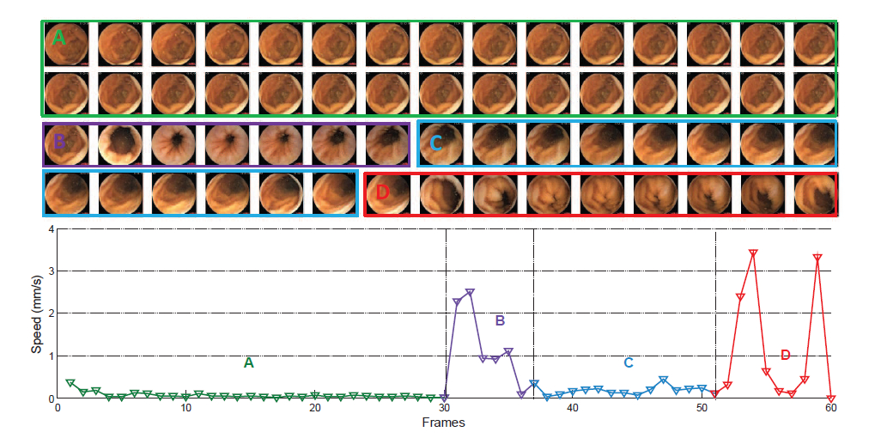
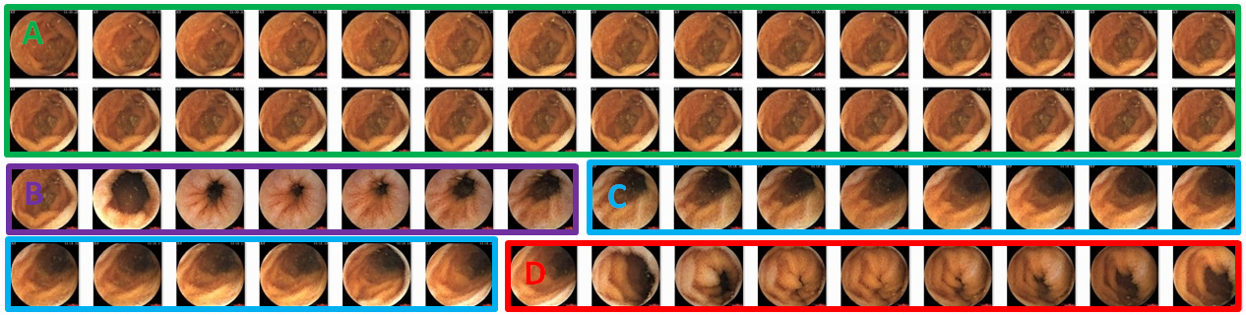
  Modeling the speed of WCE using clinical data
The above figure shows a sequence of 60 endoscopic frames. After applying our speed estimation algorithm, a plot of the corresponding speed is given underneath. It can be seen that during section A and C, the scene almost stays still which indicates a slow motion of the capsule, while in section B and D, the capsule moves faster. The trend of the corresponding speed estimation plot matches this observation.
G. Bao, L. Mi, Y. Geng, M. Zhou and K. Pahlavan, “A Video-based Speed Estimation Technique for Localizing the Wireless Capsule Endoscope inside Gastrointestinal Tract, ” submitted to IEEE Engineering in Medicine and Biology Society (EMBC’14), March, 2014.
G. Bao, L. Mi and K. Pahlavan, “Hybrid Localization of Micro-robotic Endoscopic Capsule inside Small Intestine by Data Fusion of Vision and RF Sensors”, submitted to Sensor Journal, IEEE, March, 2014.

Slide 21
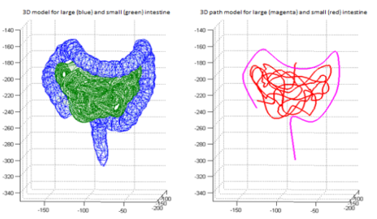
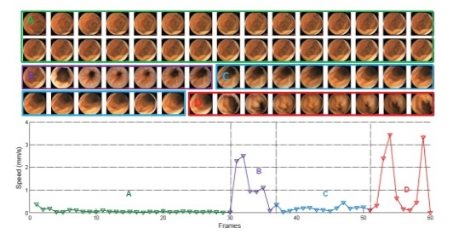
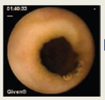
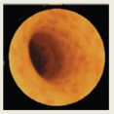
Performance evaluation using testbed
Since experiment inside human body is not feasible, the only way to do quantitative performance evaluation is through establishing an emulation test bed.
Map generation
Generating emulated endoscopic images
Modeling the Speed of WCE using Endoscopic Images

Slide 22

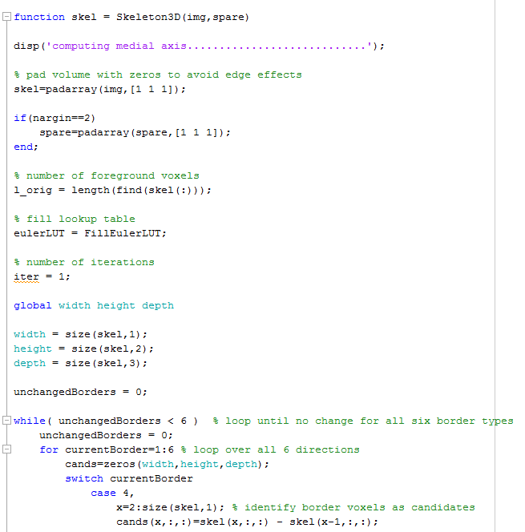
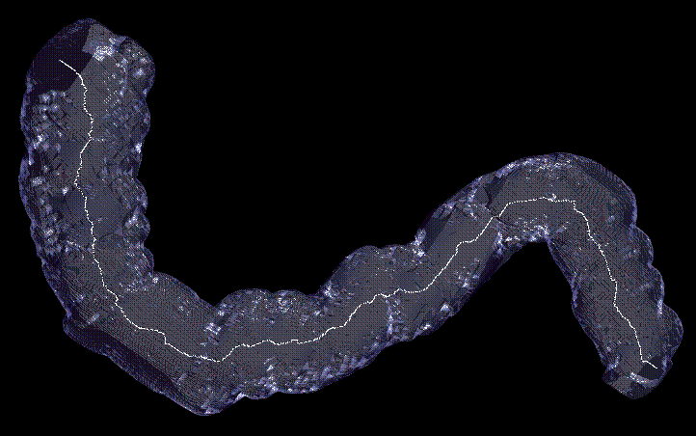
Map generation
K. Palágyi and A. Kuba, “A 3D 6-subiteration thinning algorithm for extracting medial lines”, Pattern Recognition Letters, Vol.19, pp 613-627, 1998.
  G. Bao, Y. Ye, U. Khan, X. Zheng and K. Pahlavan, "Modeling of the Movement of the Endoscopy Capsule inside GI Tract based on the Captured Endoscopic Images" , The 2012 International Conference on Modeling, Simulation and Visualization Methods (MSV), Las Vegas, USA, July, 2012.

Slide 23
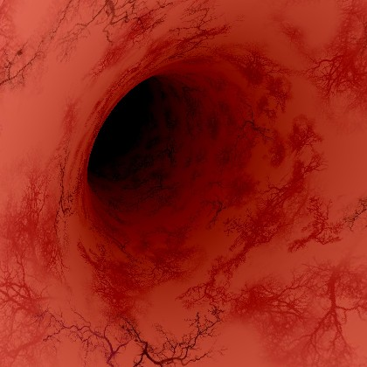
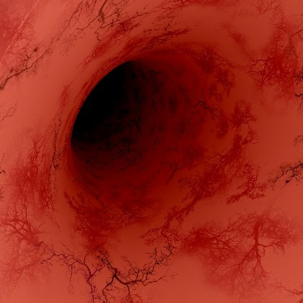










Generating the emulated images and import the motion model
Phong reflection model
[L. Mi, G. Bao and K. Pahlavan, "Design and Validation of a Virtual Environment for Experimentation inside the Small Intestine", 8th International Conference on Body Area Networks, Boston, Massachusetts, United States, September 30 - October 2, 2013.
L. Mi, G. Bao and K. Pahlavan, "Geometric Estimation of Intestinal Contraction for Motion Tracking of Video Capsule Endoscope", SPIE Medical Imaging: Image-Guided Procedures, Robotic Interventions, and Modeling, San Diego, California, February 15-20, 2014.

Slide 24

Experimental results
By using Body-SLAM, the trajectory (map) of the capsule has traveled can be accurately reconstructed..
G. Bao, L. Mi and K. Pahlavan, "A Video Aided RF Localization Technique for the Wireless Capsule Endoscope (WCE) inside Small Intestine," 8th International Conference on Body Area Networks, Boston, Massachusetts, United States, September 30 - October 2, 2013.
G. Bao, Y. Ye, U. Khan, X. Zheng and K. Pahlavan, "Modeling of the Movement of the Endoscopy Capsule inside GI Tract based on the Captured Endoscopic Images" , The 2012 International Conference on Modeling, Simulation and Visualization Methods (MSV), Las Vegas, USA, July, 2012.
G. Bao, L. Mi, Y. Geng and K. Pahlavan, “A Computer Vision based Speed Estimation Technique for Localizing the Wireless Capsule Endoscope inside Small Intestine,” submitted to Signal Processing Letters, IEEE, April, 2014.

Slide 25

Experimental results
By using Body-SLAM, we can enhance the positioning accuracy of WCE from 8 cm to 2.3 cm on average.
G. Bao, L. Mi and K. Pahlavan, "A Video Aided RF Localization Technique for the Wireless Capsule Endoscope (WCE) inside Small Intestine," 8th International Conference on Body Area Networks, Boston, Massachusetts, United States, September 30 - October 2, 2013.
G. Bao, Y. Ye, U. Khan, X. Zheng and K. Pahlavan, "Modeling of the Movement of the Endoscopy Capsule inside GI Tract based on the Captured Endoscopic Images" , The 2012 International Conference on Modeling, Simulation and Visualization Methods (MSV), Las Vegas, USA, July, 2012.
G. Bao, L. Mi, Y. Geng and K. Pahlavan, “A Computer Vision based Speed Estimation Technique for Localizing the Wireless Capsule Endoscope inside Small Intestine,” submitted to Signal Processing Letters, IEEE, April, 2014.

Slide 26
Conclusion and Feature Direction
Conclusion
We demonstrated that by combining endoscopic images with RF measurements, we can enhance the positioning accuracy of WCE from 10 cm to 2.3 cm.
The proposed Body-SLAM technique provides a promising way to map the small intestine ( other imaging tools, for example CT and MRI can not do) that might be useful for other purposes.
Future Direction
Enhance the performance of the Body-SLAM algorithm using more complicated Extended Kalman Filter (EKF).
Explore the possibility of using ToA based RF localization.

Slide 27
Complete Publication List
Thesis related (WPI)
[1] G. Bao, Y. Ye, U. Khan, X. Zheng and K. Pahlavan, "Modeling of the Movement of the Endoscopy Capsule inside GI Tract based on the Captured Endoscopic Images" , The 2012 International Conference on Modeling, Simulation and Visualization Methods (MSV), Las Vegas, USA, July, 2012.
[2] G. Bao and K. Pahlavan, "Motion Estimation of the Endoscopy Capsule using Region-based Kernel SVM Classifier", 2013 IEEE International Conference on Electro/Information Technology (EIT), Rapid City, SD, May 9-11, 2013.
[5] K. Pahlavan, G. Bao, et al. , "RF localization for wireless video capsule endoscopy". International Journal of Wireless Information Networks, Vol.19 (4), pp.326-340, 2012.
[6] G. Bao, L. Mi and K. Pahlavan, "Emulation on Motion Tracking of Endoscopic Capsule inside Small Intestine", 2013 World Congress in Computer Science, Computer Engineering, and Applied Computing (WORLDCOMP'13), Las Vegas, USA, 2013.
[7] G. Bao, L. Mi and K. Pahlavan, "A Video Aided RF Localization Technique for the Wireless Capsule Endoscope (WCE) inside Small Intestine," 8th International Conference on Body Area Networks, Boston, Massachusetts, United States, September 30 - October 2, 2013.
[8] L. Mi, G. Bao and K. Pahlavan, "Design and Validation of a Virtual Environment for Experimentation inside the Small Intestine", 8th International Conference on Body Area Networks, Boston, Massachusetts, United States, September 30 - October 2, 2013.
[9] L. Mi, G. Bao and K. Pahlavan, "Geometric Estimation of Intestinal Contraction for Motion Tracking of Video Capsule Endoscope", SPIE Medical Imaging: Image-Guided Procedures, Robotic Interventions, and Modeling, San Diego, California, February 15-20, 2014.
[3] G. Bao, L. Mi, Y. Geng and K. Pahlavan, “A Computer Vision based Speed Estimation Technique for Localizing the Wireless Capsule Endoscope inside Small Intestine,” submitted to Signal Processing Letters, IEEE, April, 2014.
[4] G. Bao, L. Mi, Y. Geng, M. Zhou and K. Pahlavan, “A Video-based Speed Estimation Technique for Localizing the Wireless Capsule Endoscope inside Gastrointestinal Tract, ” submitted to IEEE Engineering in Medicine and Biology Society (EMBC’14), March, 2014.
[10] M. Zhou, G. Bao and K. Pahlavan, “Mutual Information based Motion Tracking Technique for the WCE inside Large Intestine,”, submitted to IEEE Engineering in Medicine and Biology Society (EMBC’14), March, 2014.
[11] G. Bao, L. Mi and K. Pahlavan, “Hybrid Localization of Micro-robotic Endoscopic Capsule inside Small Intestine by Data Fusion of Vision and RF Sensors”, submitted to Sensor Journal, IEEE, March, 2014.
[12] R. Fu, G. Bao, Y. Ye and K. Pahlavan, "Heterogeneous Cooperative Localization for Social Networks", accepted by International Journal of Wireless Information Networks, special issue on indoor geolocation, 2013.
[13] X. Zheng, G. Bao, R. Fu and K. Pahlavan, "The performance of simulated annealing algorithms for wi-fi localization using google indoor map" , 2012 IEEE Vehicular Technology Conference (VTC Fall), pp.1-5, Quebec City, Canada, 3-6 September, 2012.
[14] R. Fu, G. Bao and K. Pahlavan, "Activity Classification with Empirical RF Propagation Modeling,” 8th International Conference on Body Area Networks, Boston, Massachusetts, United States, September 30 - October 2, 2013.
[16] E. Salari and G. Bao, "Super-resolution using an enhanced Papoulis-Gerchberg algorithm." IET Image Processing, Vol.6 (7), pp.959-965, 2012.
[17] E. Salari and G. Bao, "Pavement distress detection and classification using feature mapping." Electro/Information Technology (EIT), 2010 IEEE International Conference on, 2010.
[18] E. Salari and G. Bao, "Automated pavement distress inspection based on 2D and 3D information." Electro/Information Technology (EIT), IEEE International Conference on, 2011.
[19] E. Salari and G. Bao, "Pavement distress detection and severity analysis." IS&T/SPIE Electronic Imaging. International Society for Optics and Photonics, 2011.
Other publications (WPI)
Publications before come to WPI

